Slide 1
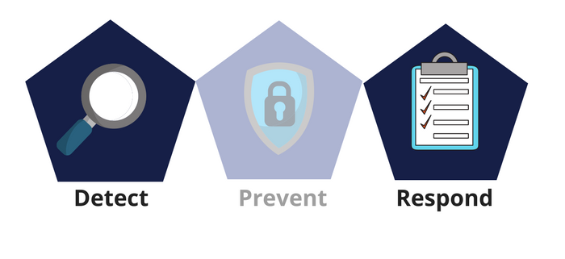



Network Security
Class X
lab 26

Slide 2


DNS Poisoning
DNS Poisoning is a technique that tricks a DNS server into believing that it has received authentic information when, in reality, it has not

Slide 3
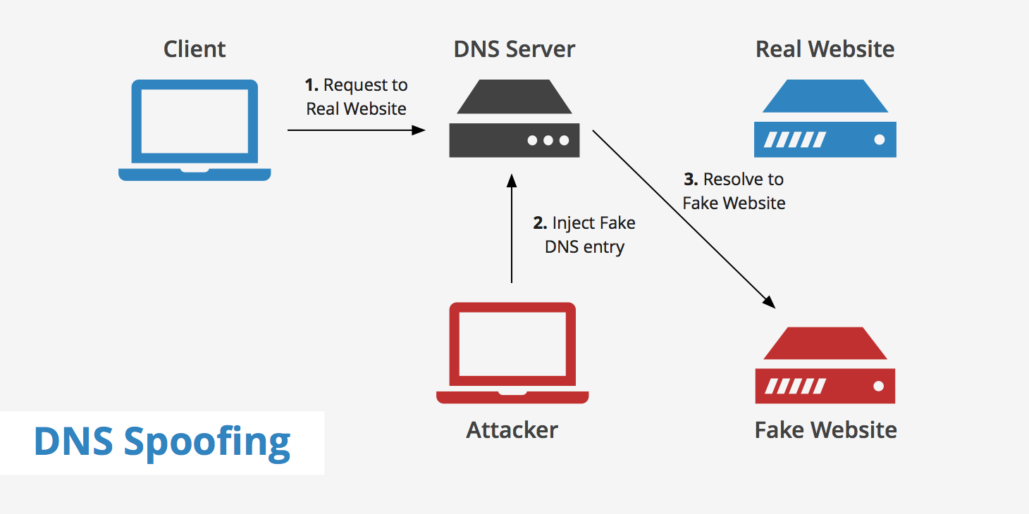
DNS Spoofing

Slide 4
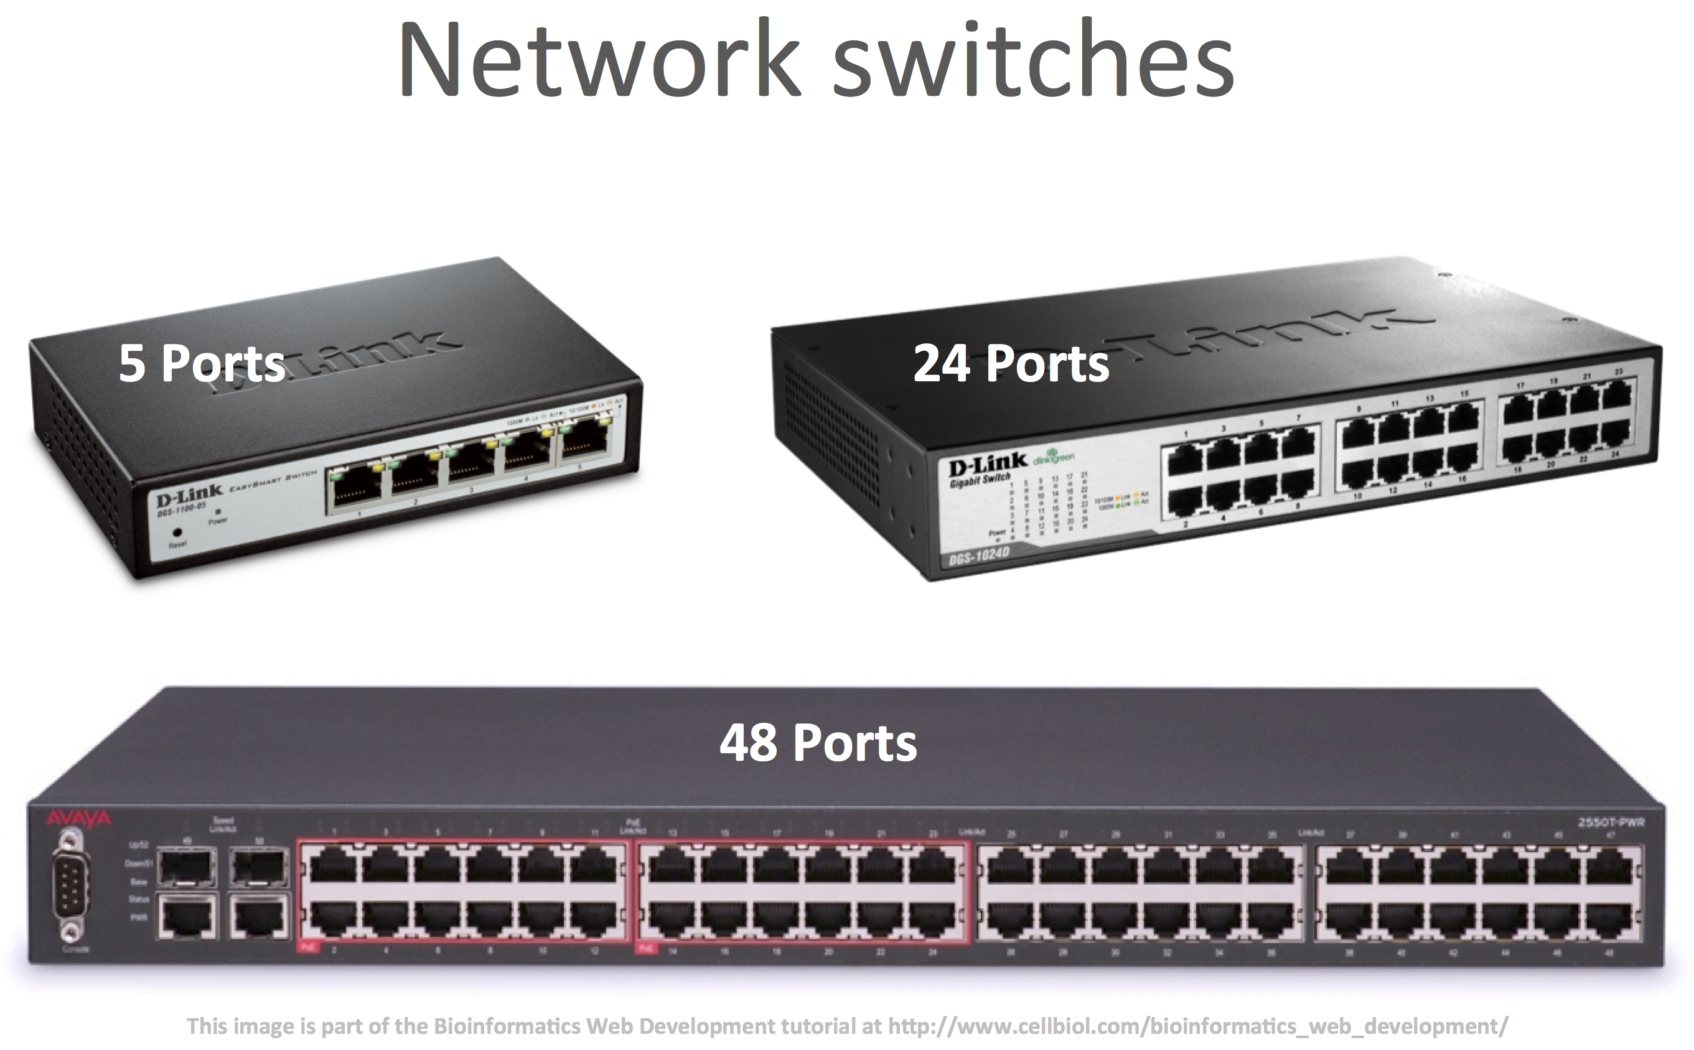
Defenses against DNS Poisoning
Use a hardware-switched network

Slide 5
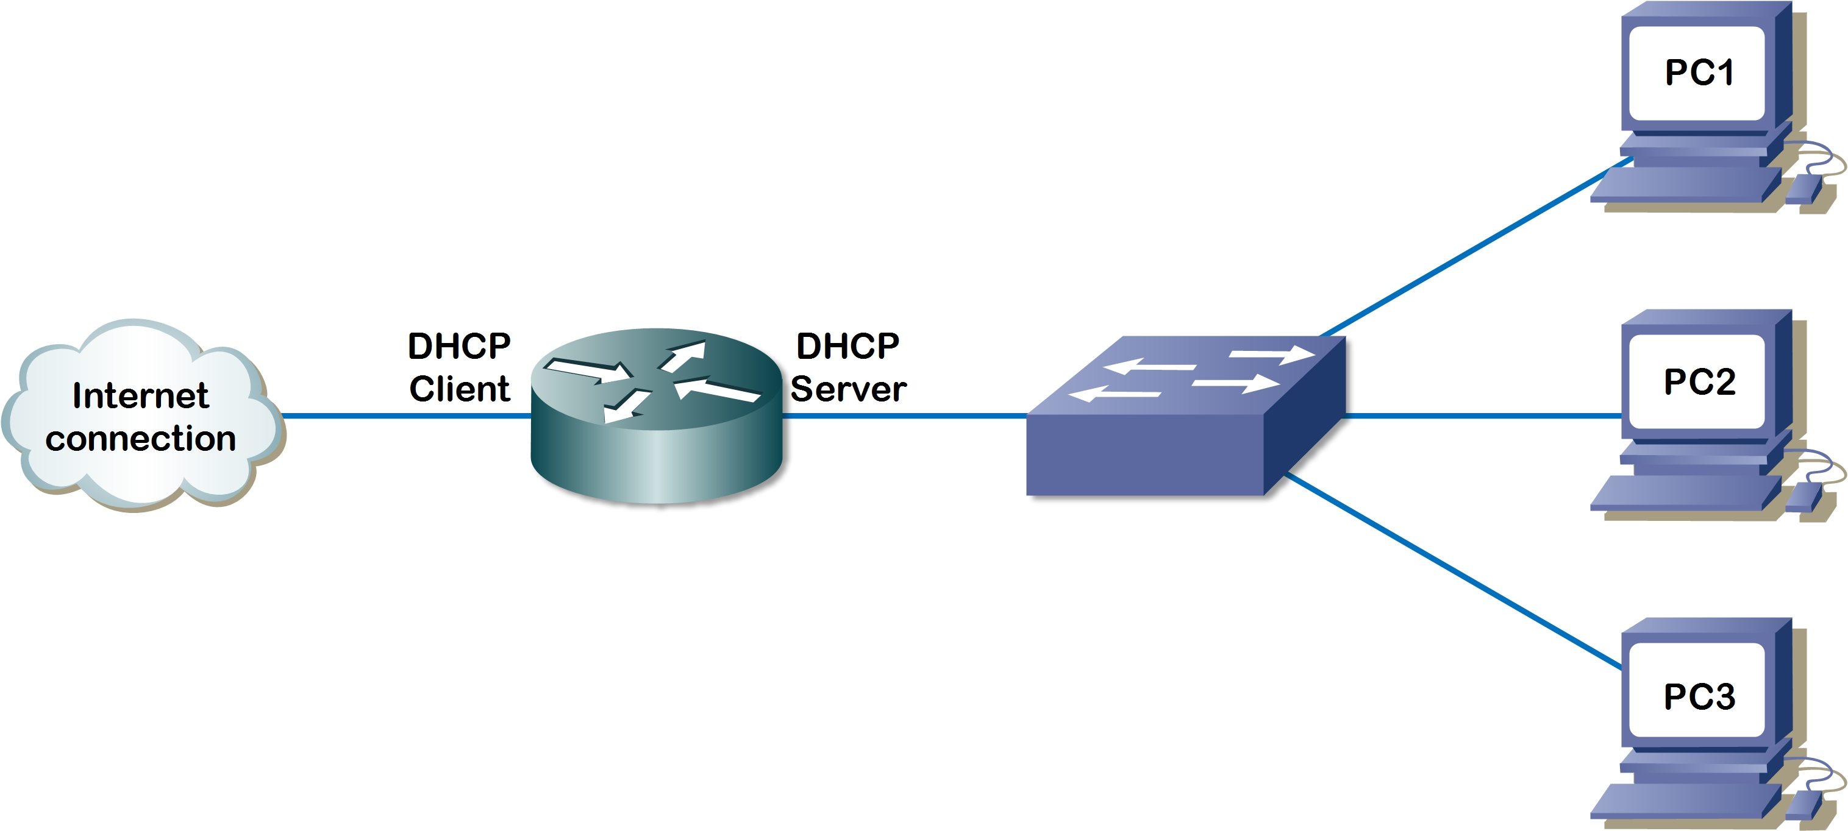
Defenses against DNS Poisoning
Implement IP DHCP Snooping on switches

Slide 6

Defenses against DNS Poisoning
Be careful when deploying
wireless access points

Slide 7
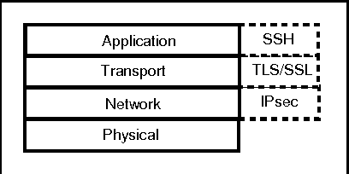
Defenses against DNS Poisoning
Encrypt your sensitive traffic

Slide 8
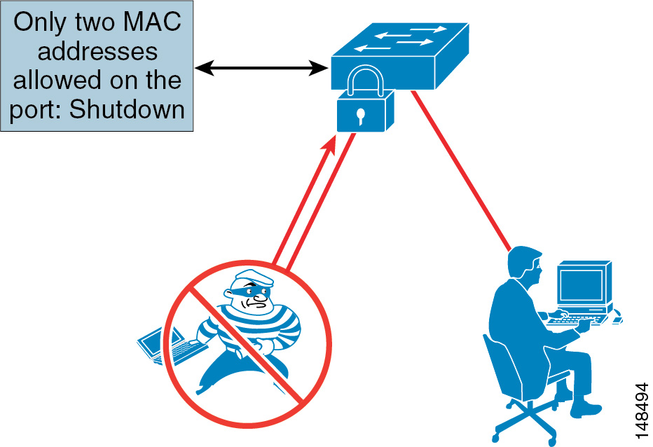
Defenses against DNS Poisoning
specifiy MAC addresses to send and receive data on each port

Slide 9
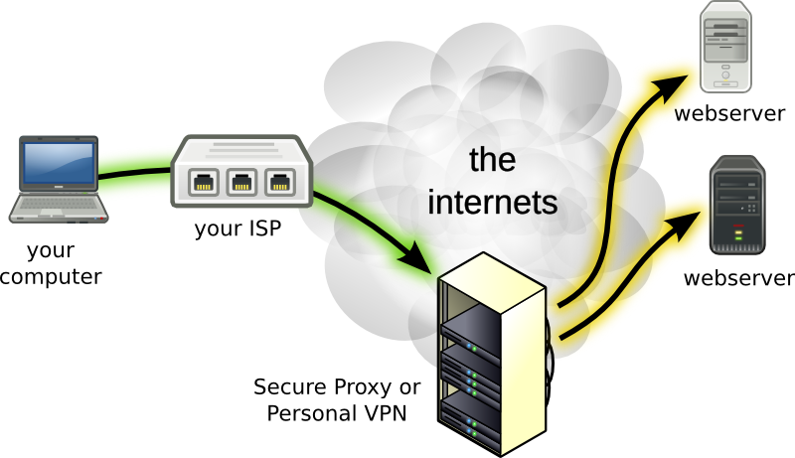
Defenses against DNS Poisoning
use VPN

Slide 10
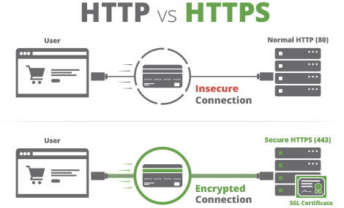
Defenses against DNS Poisoning
use SSL certificate

Slide 11
Thank You

